Slide 1


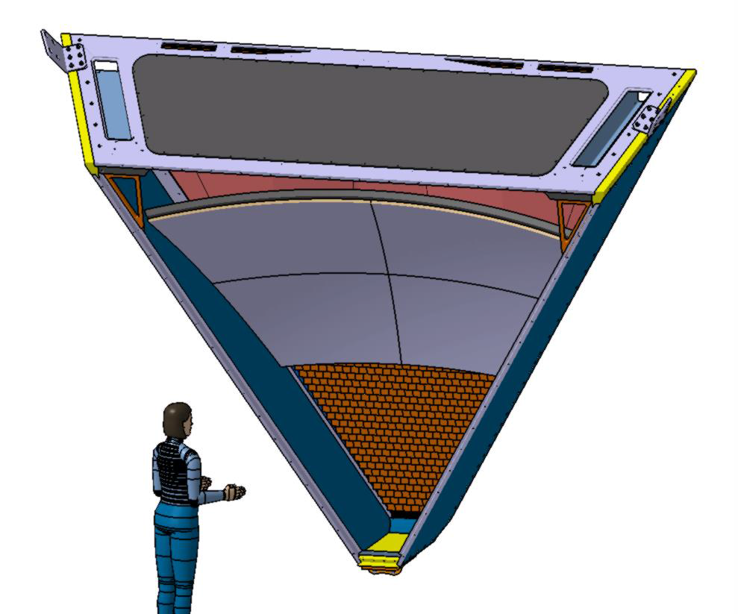

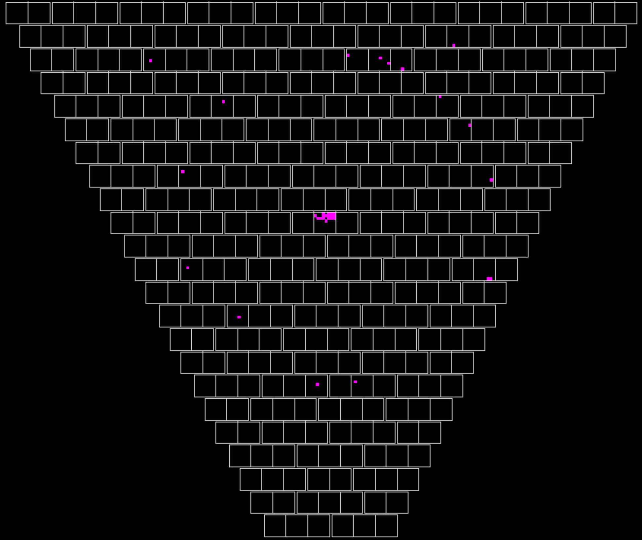
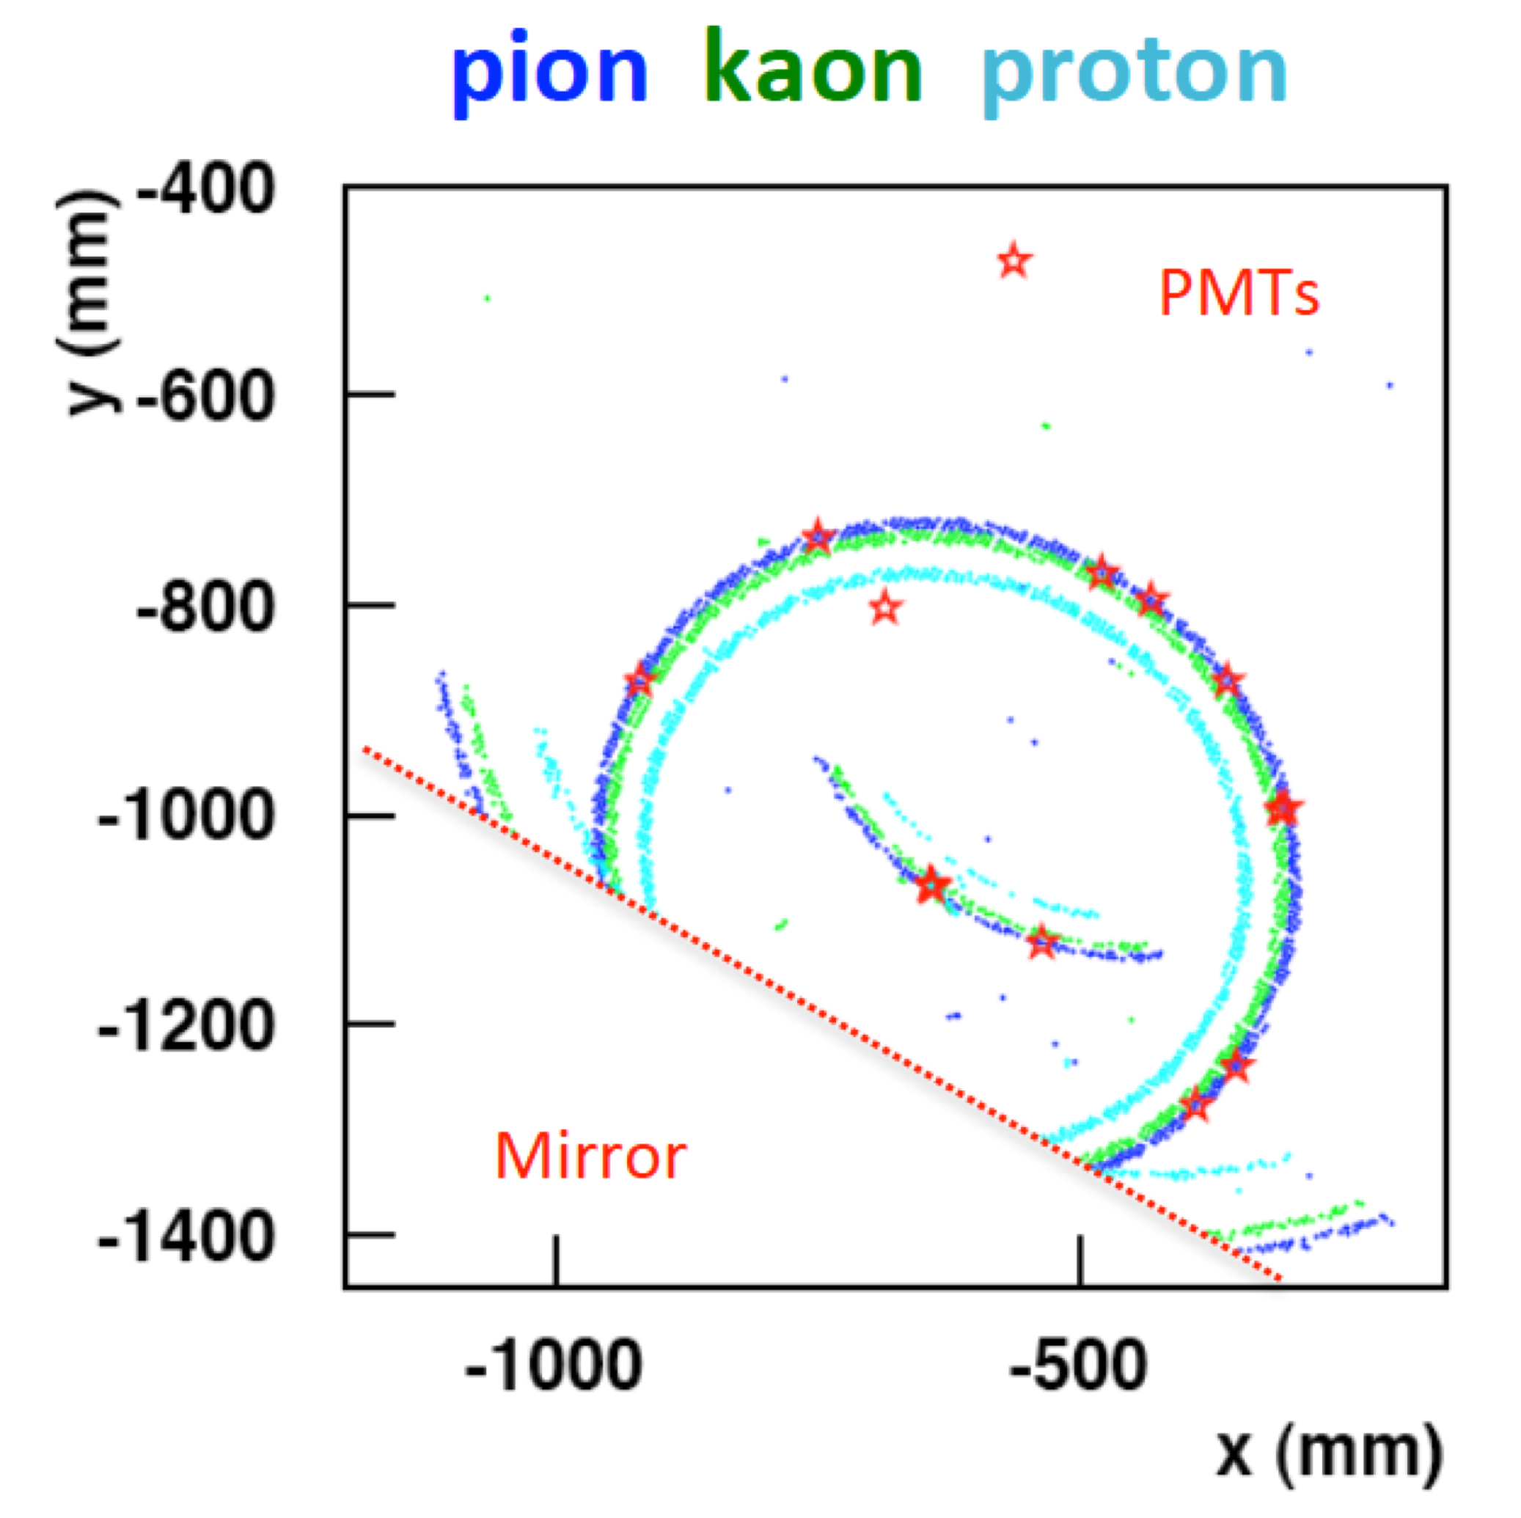
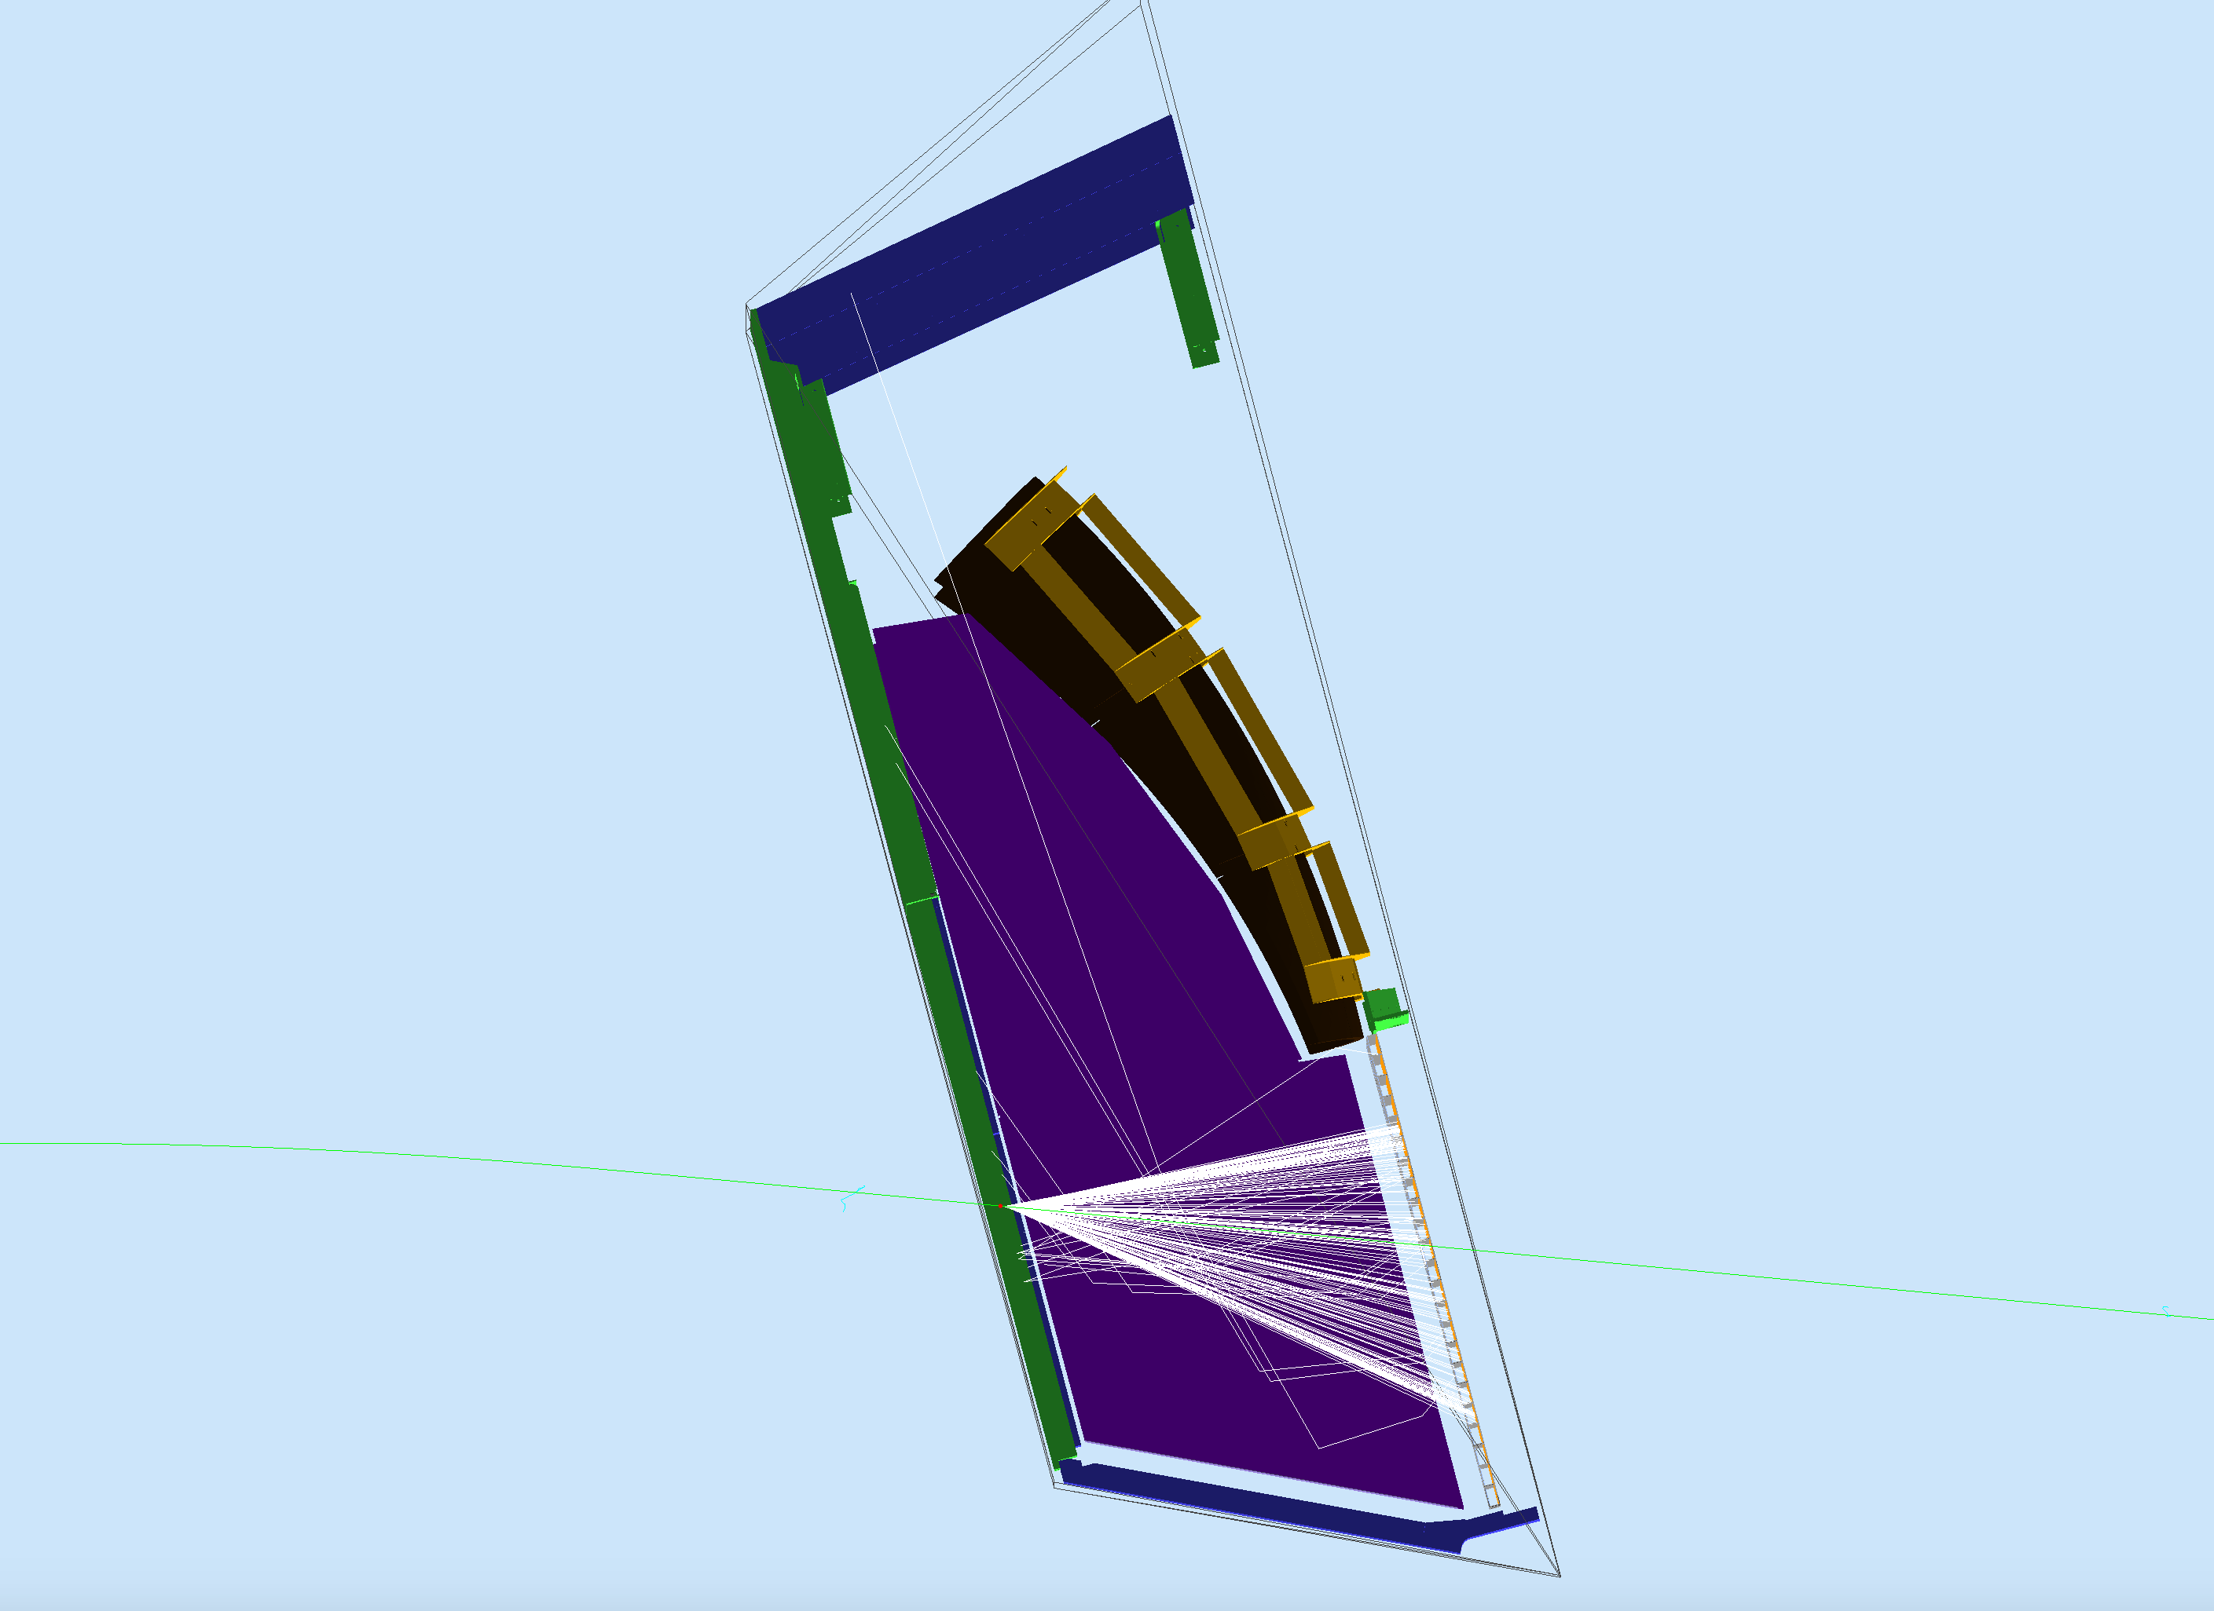
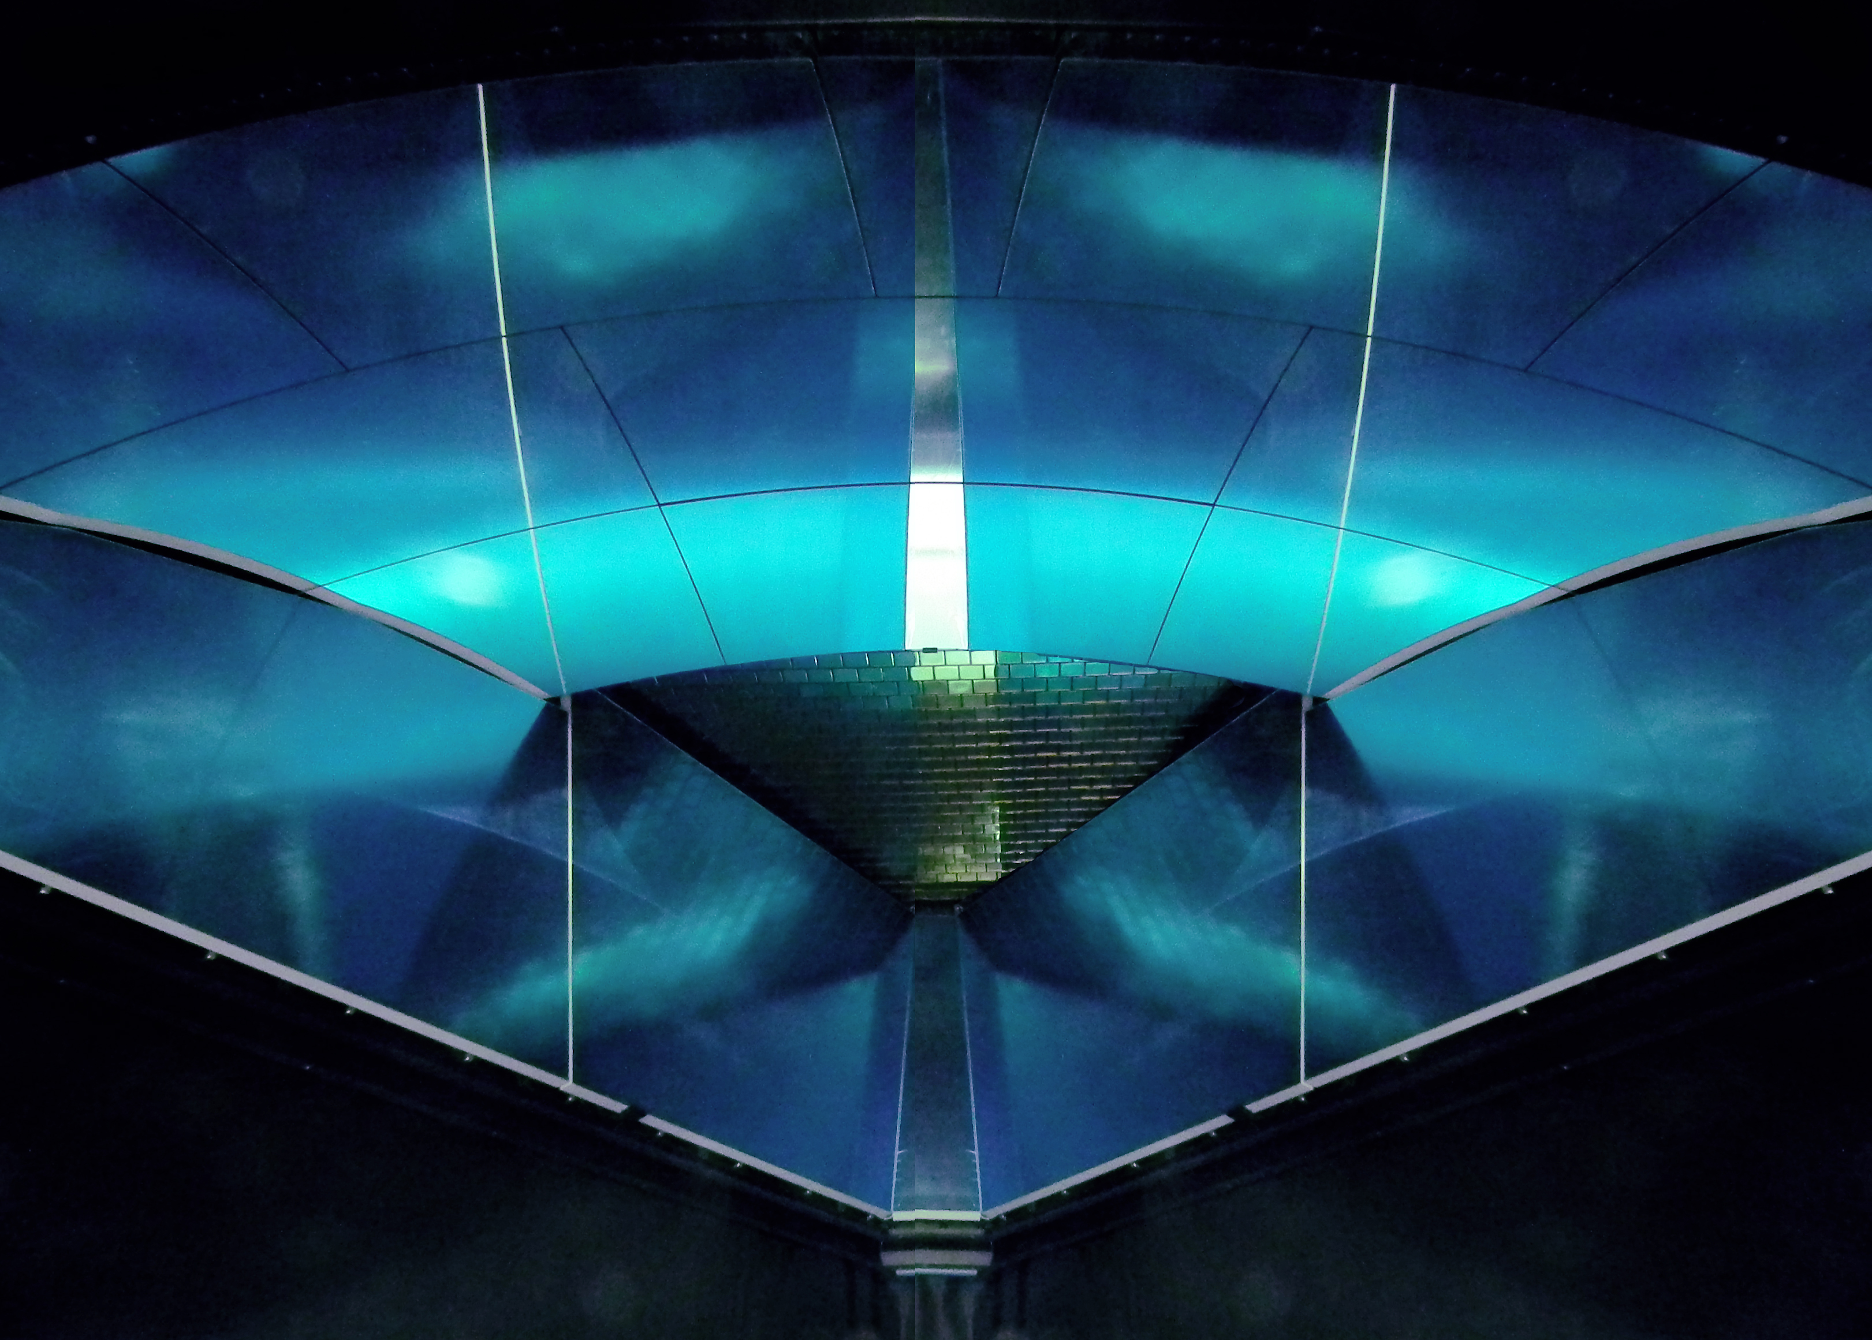
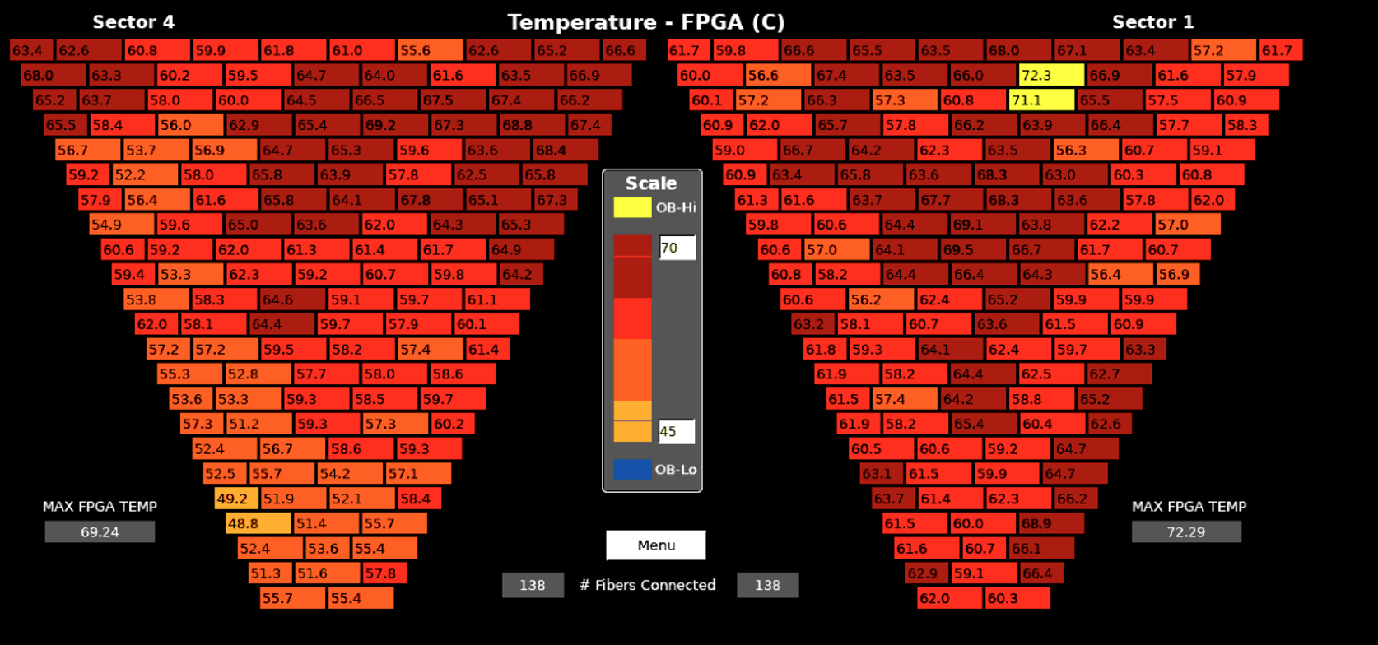
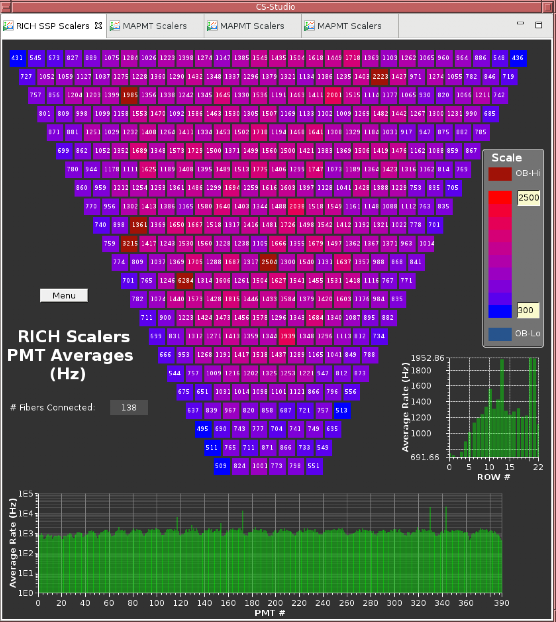
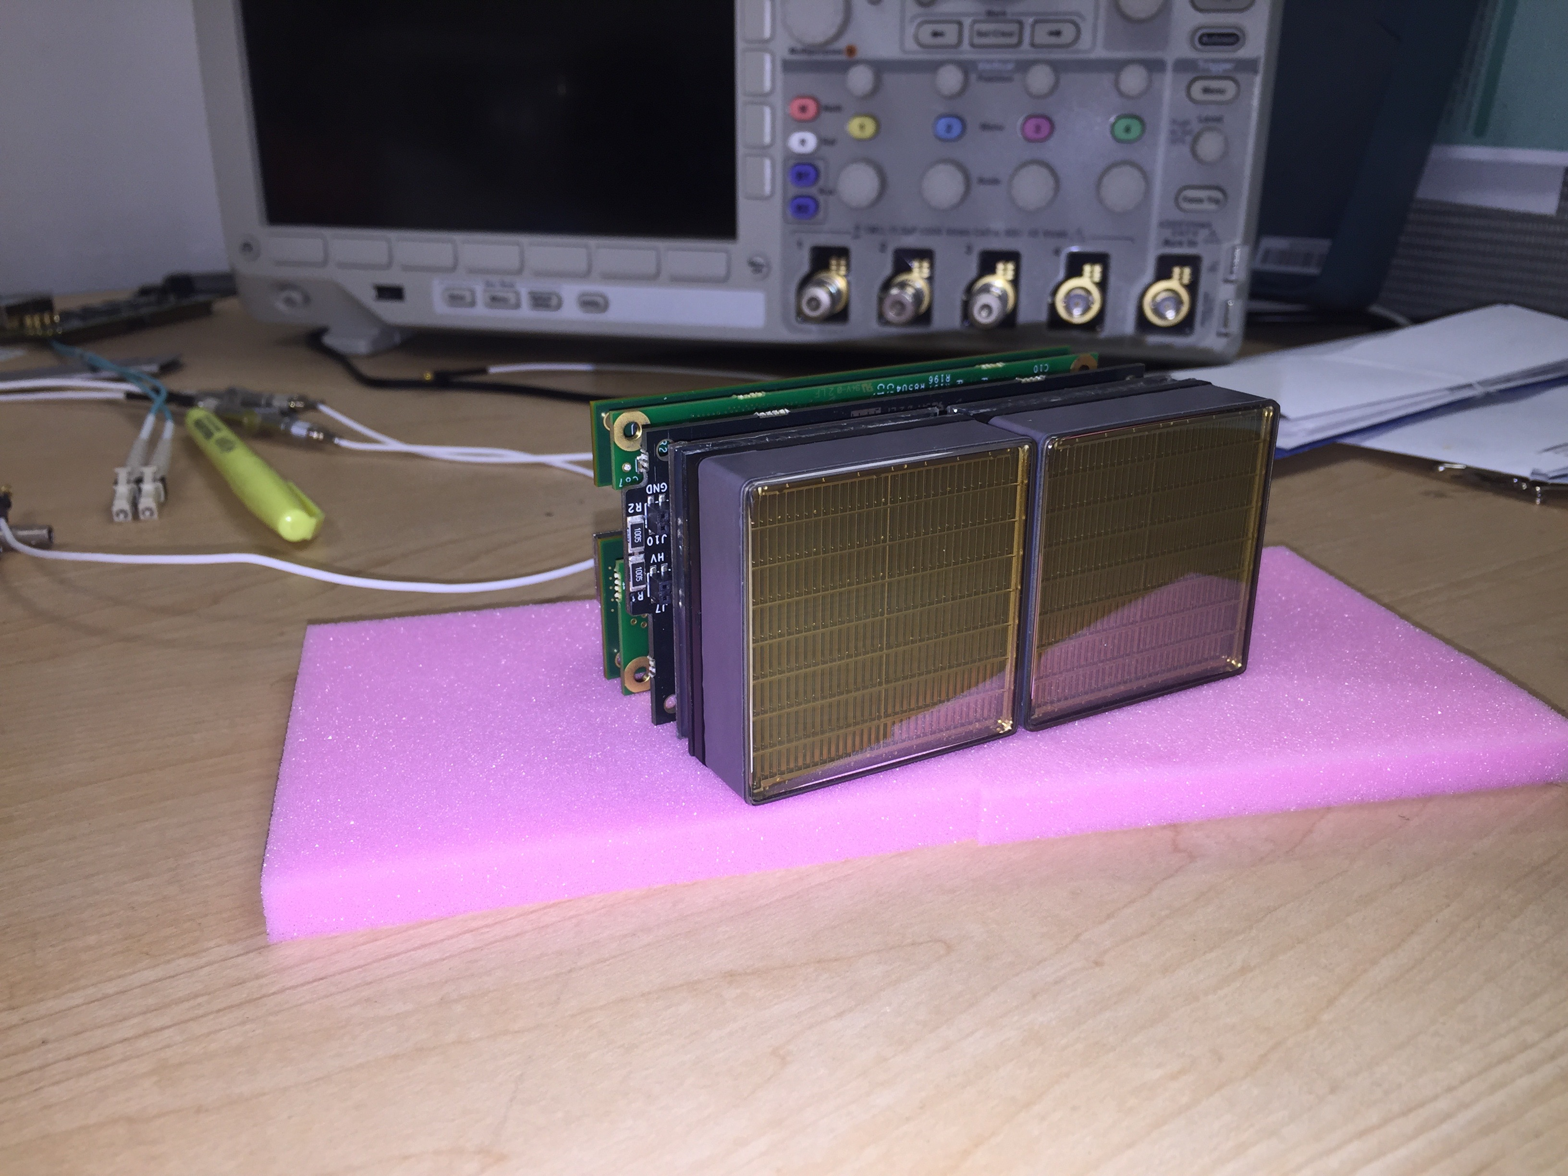
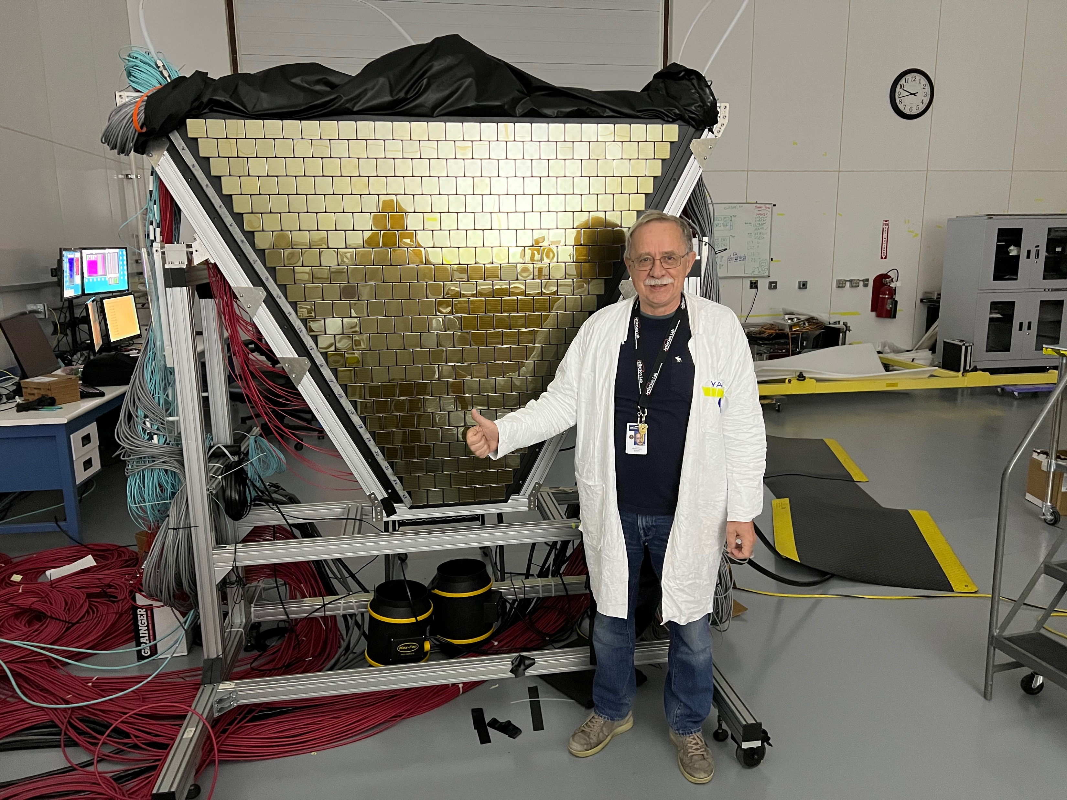
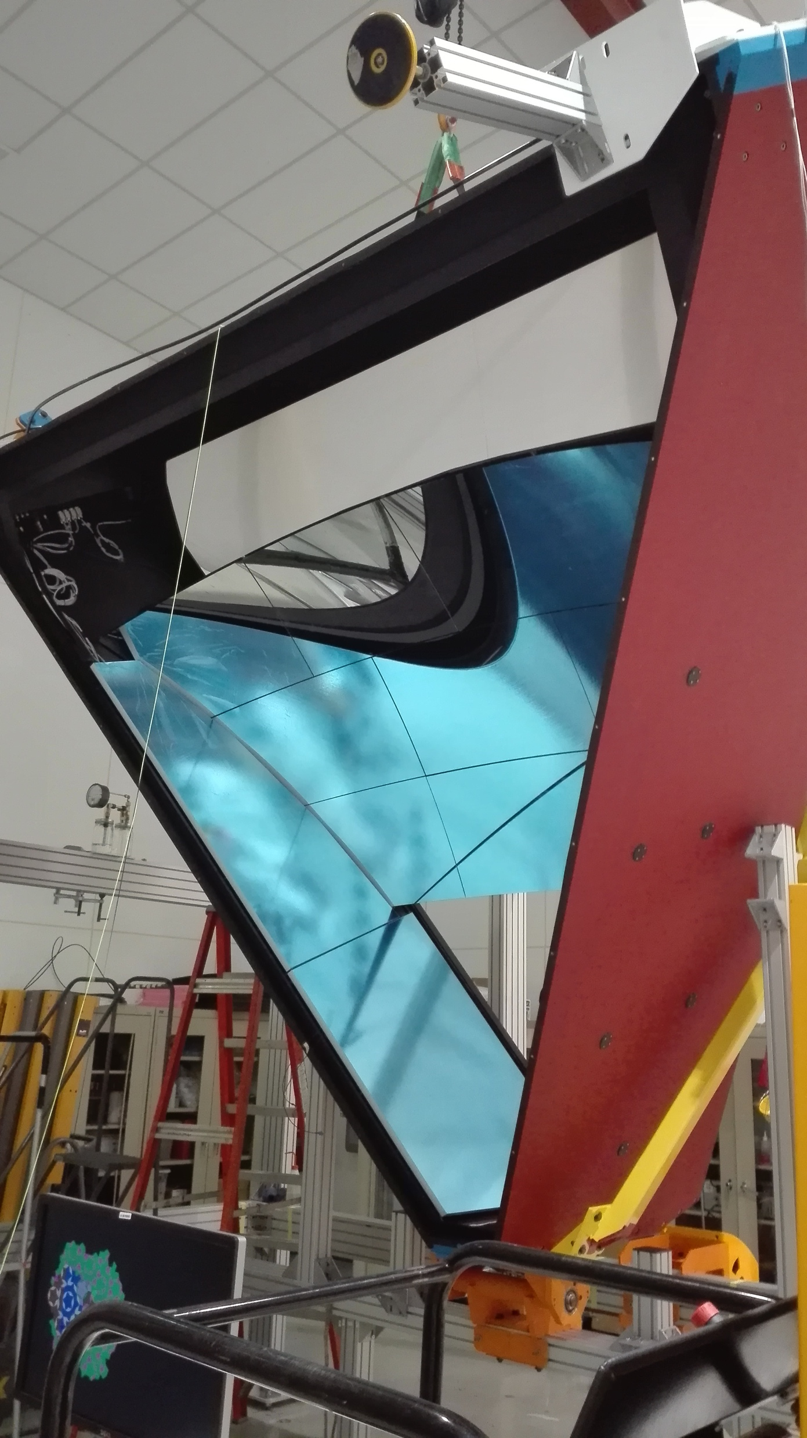
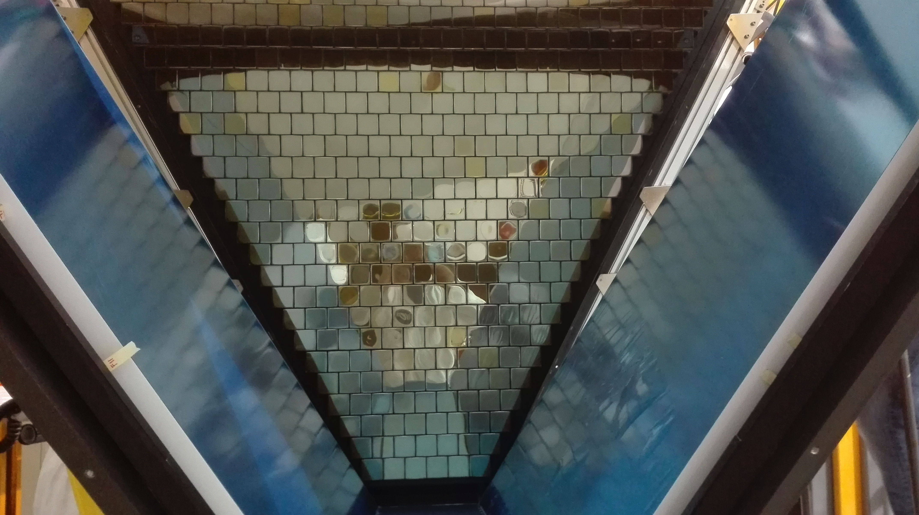
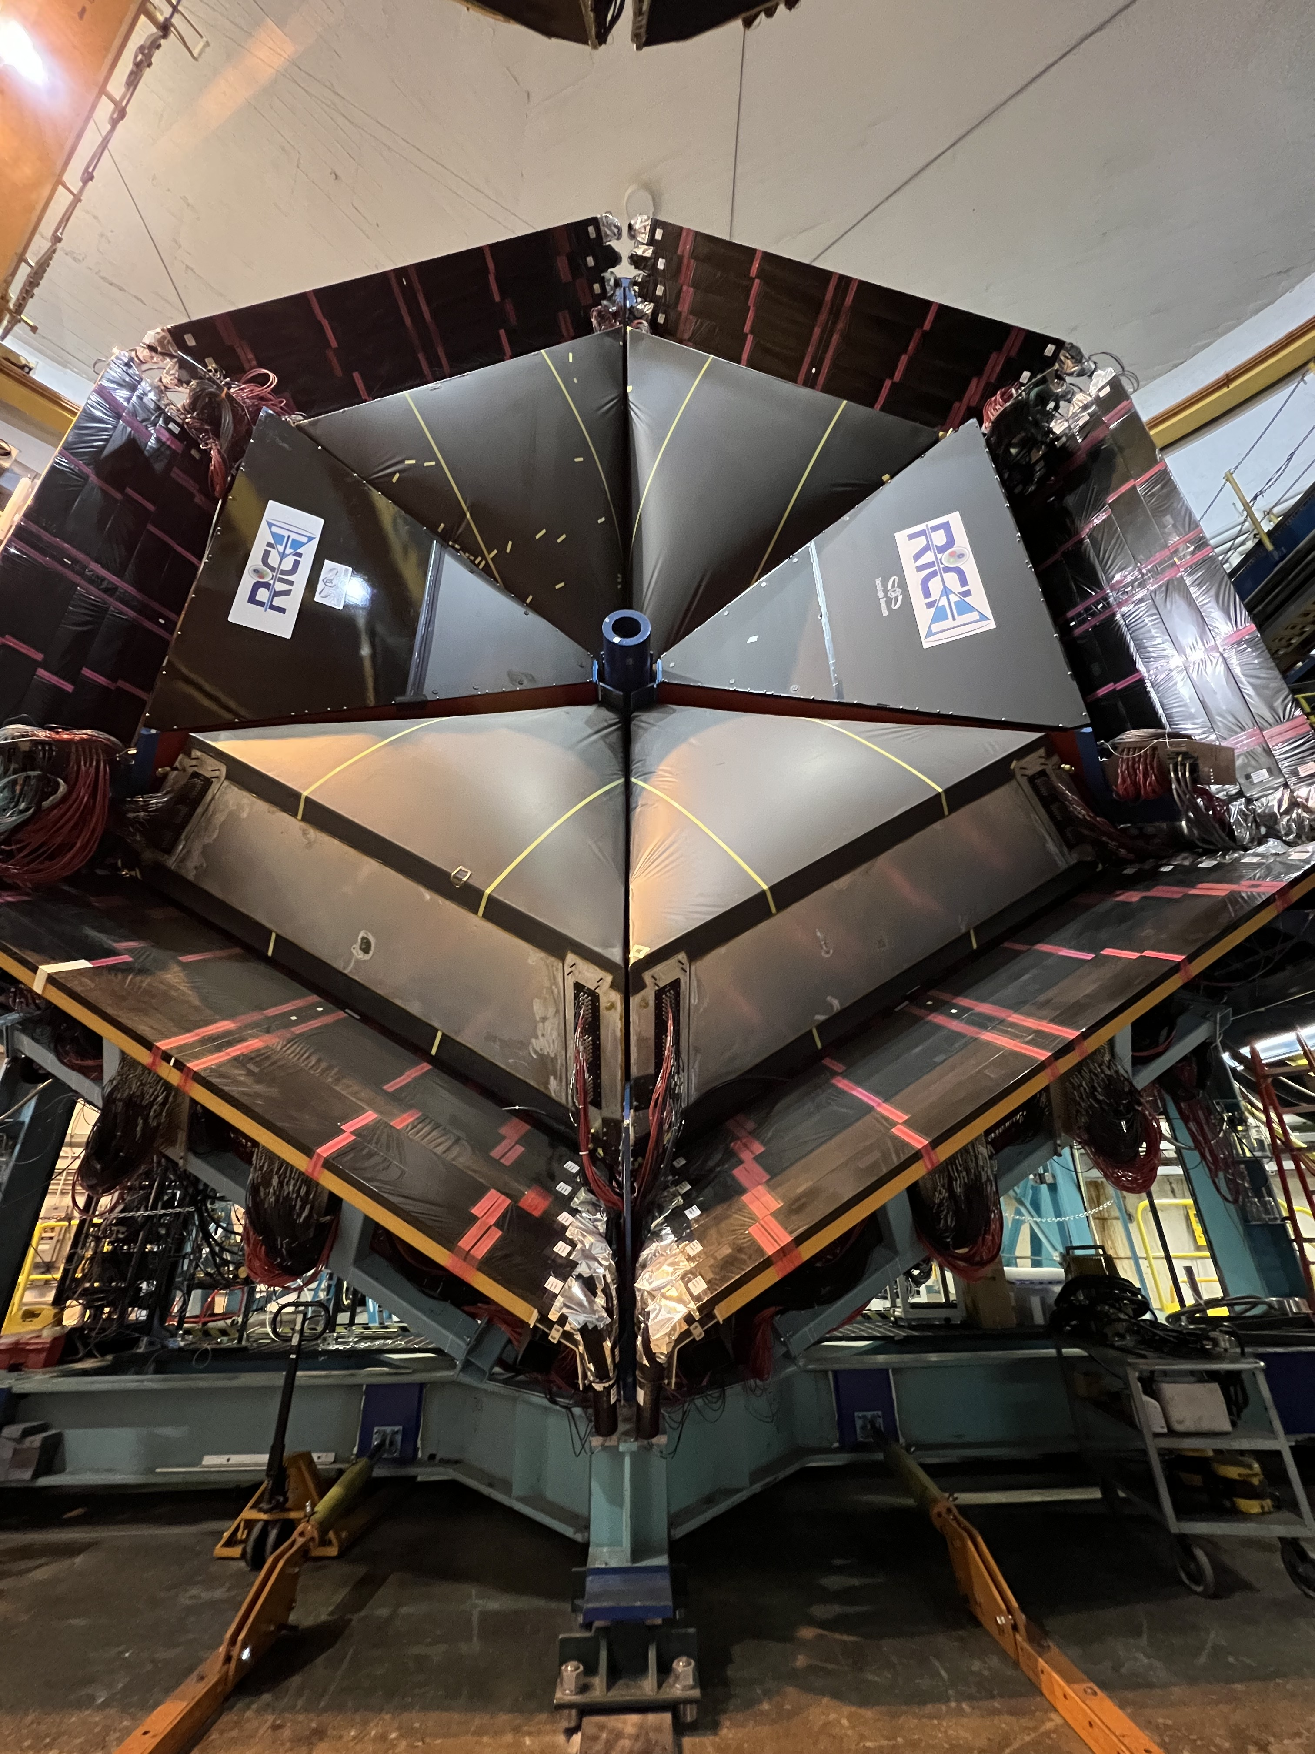
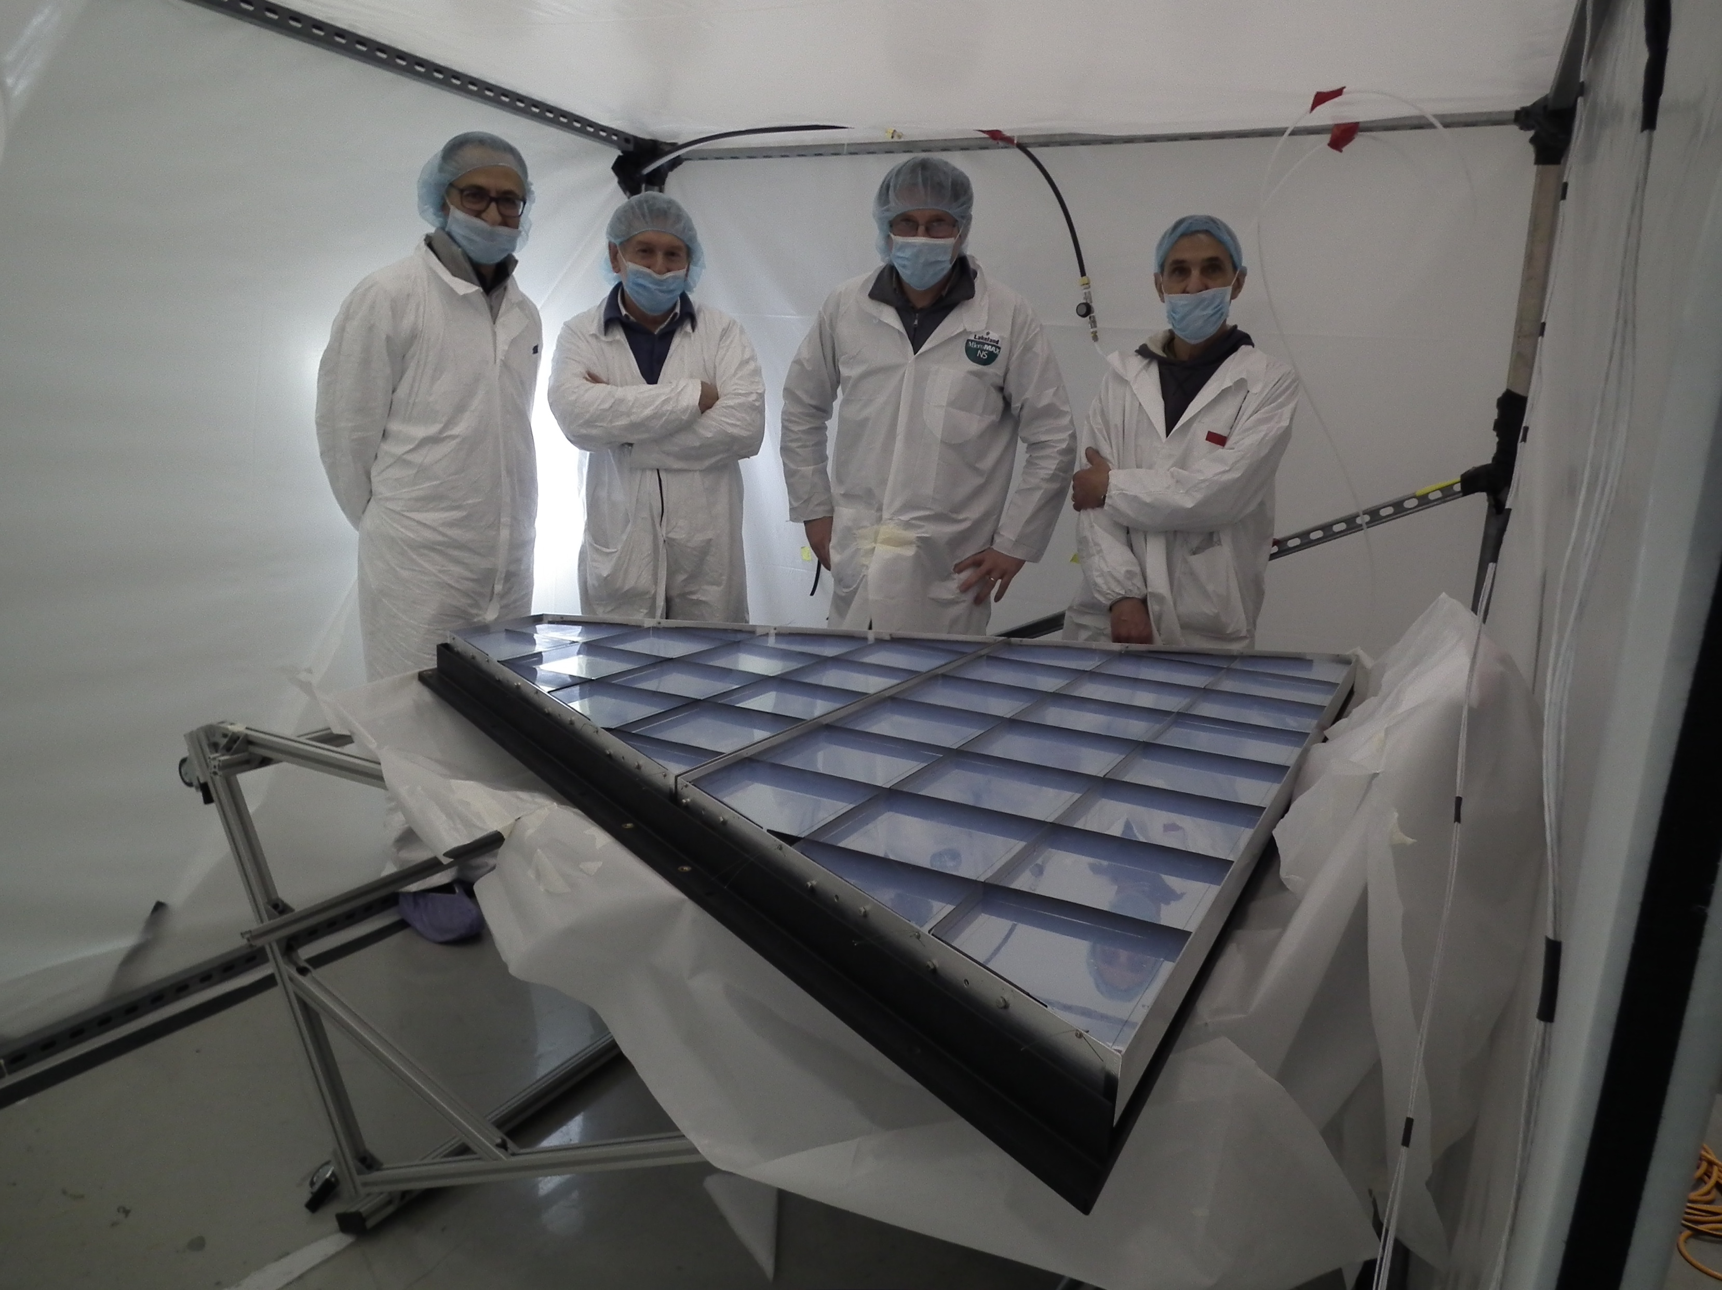

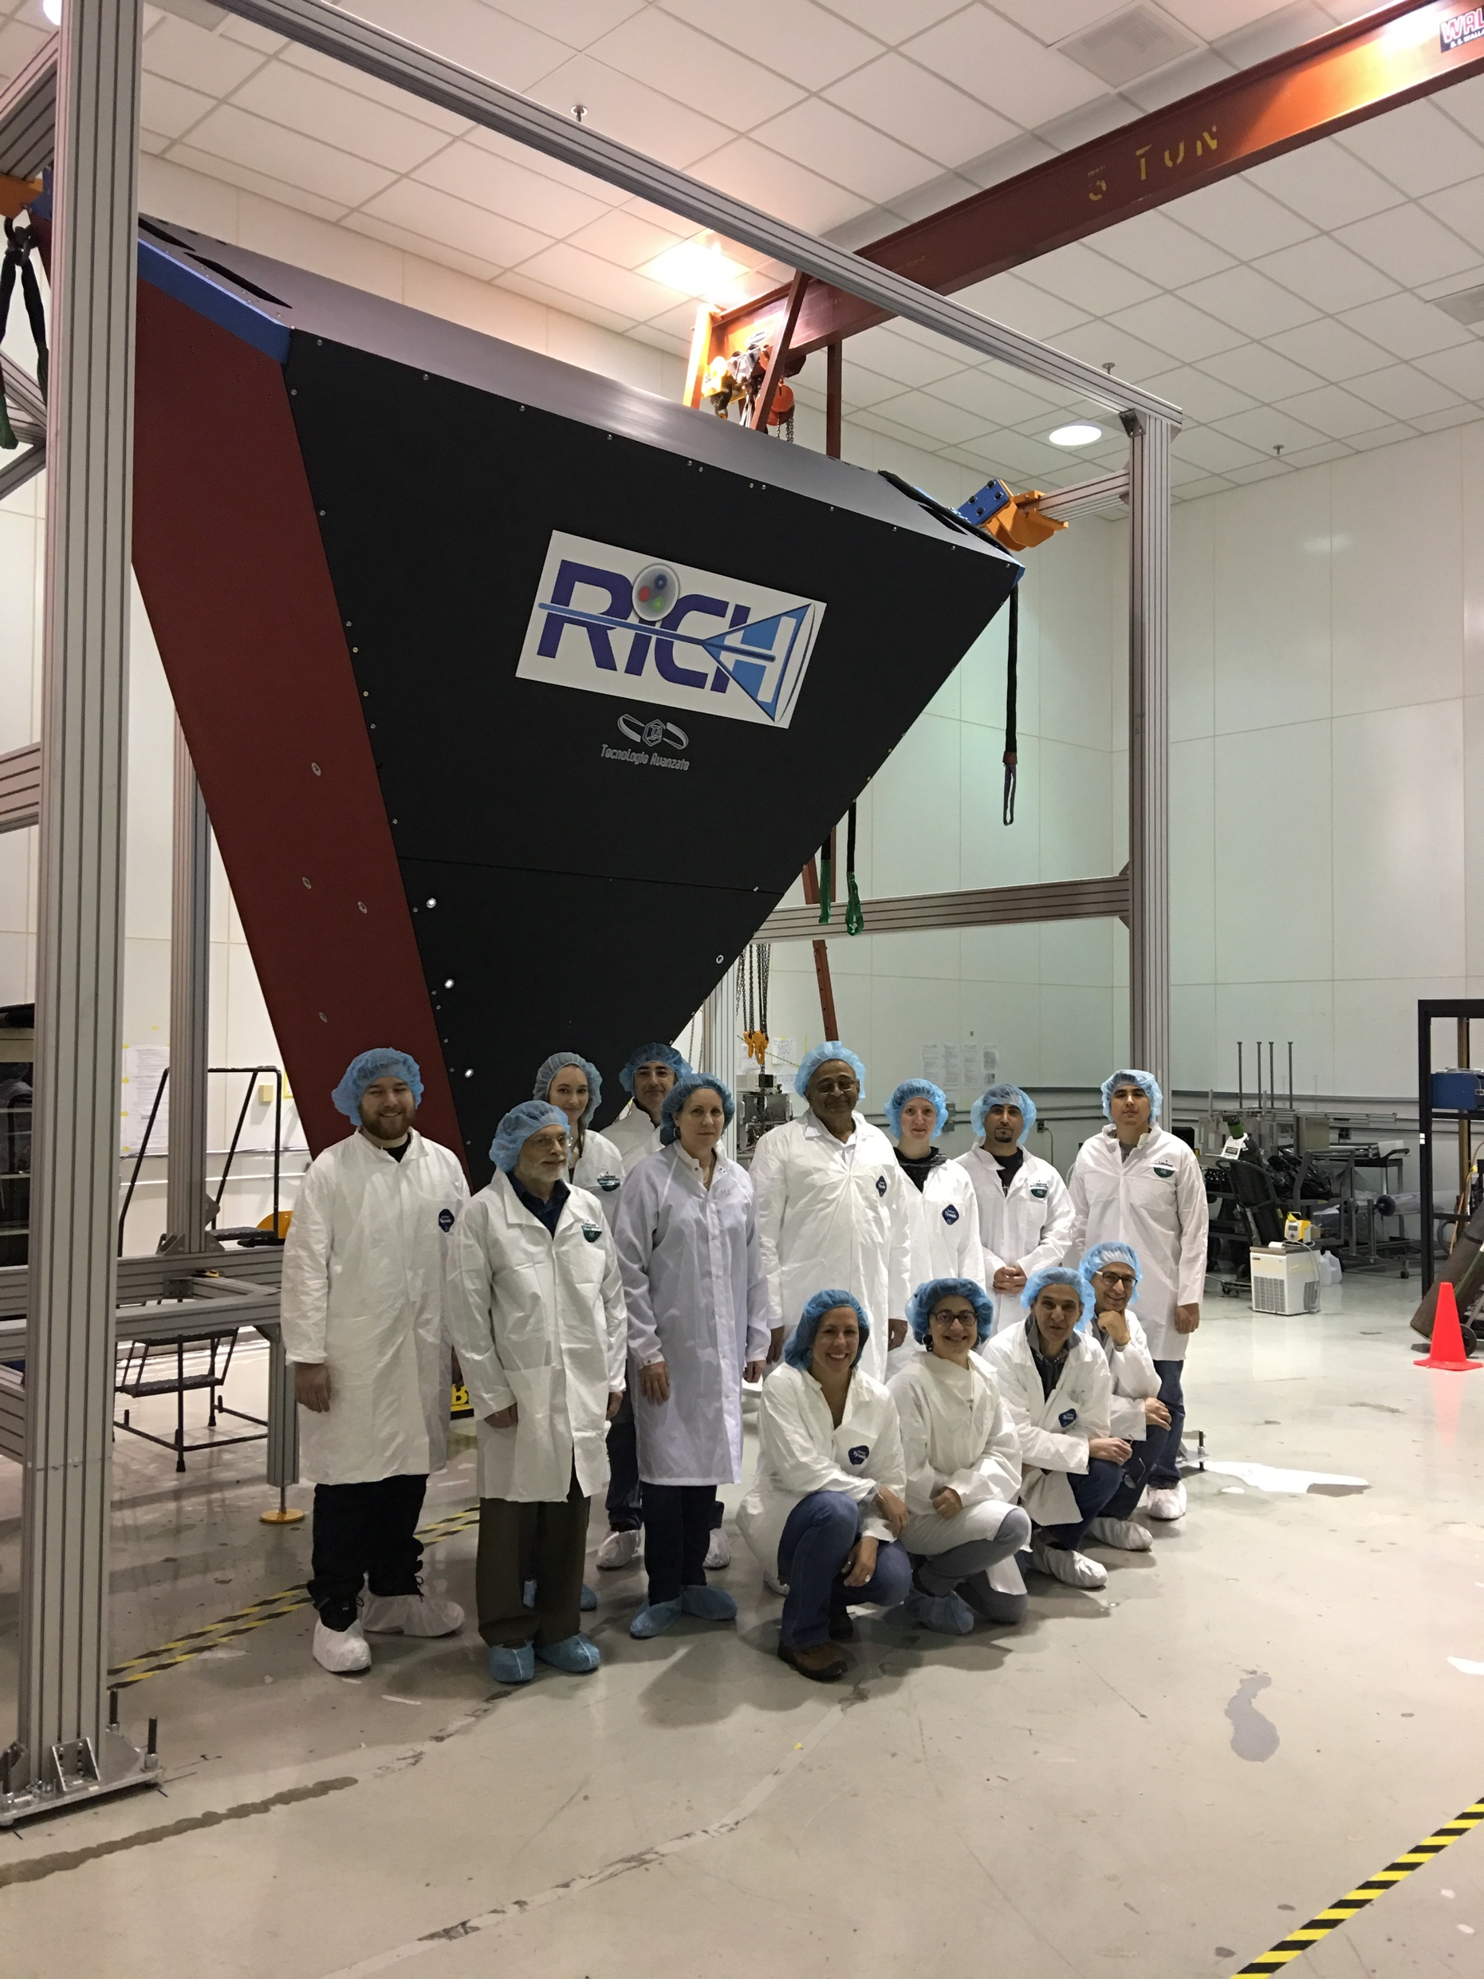
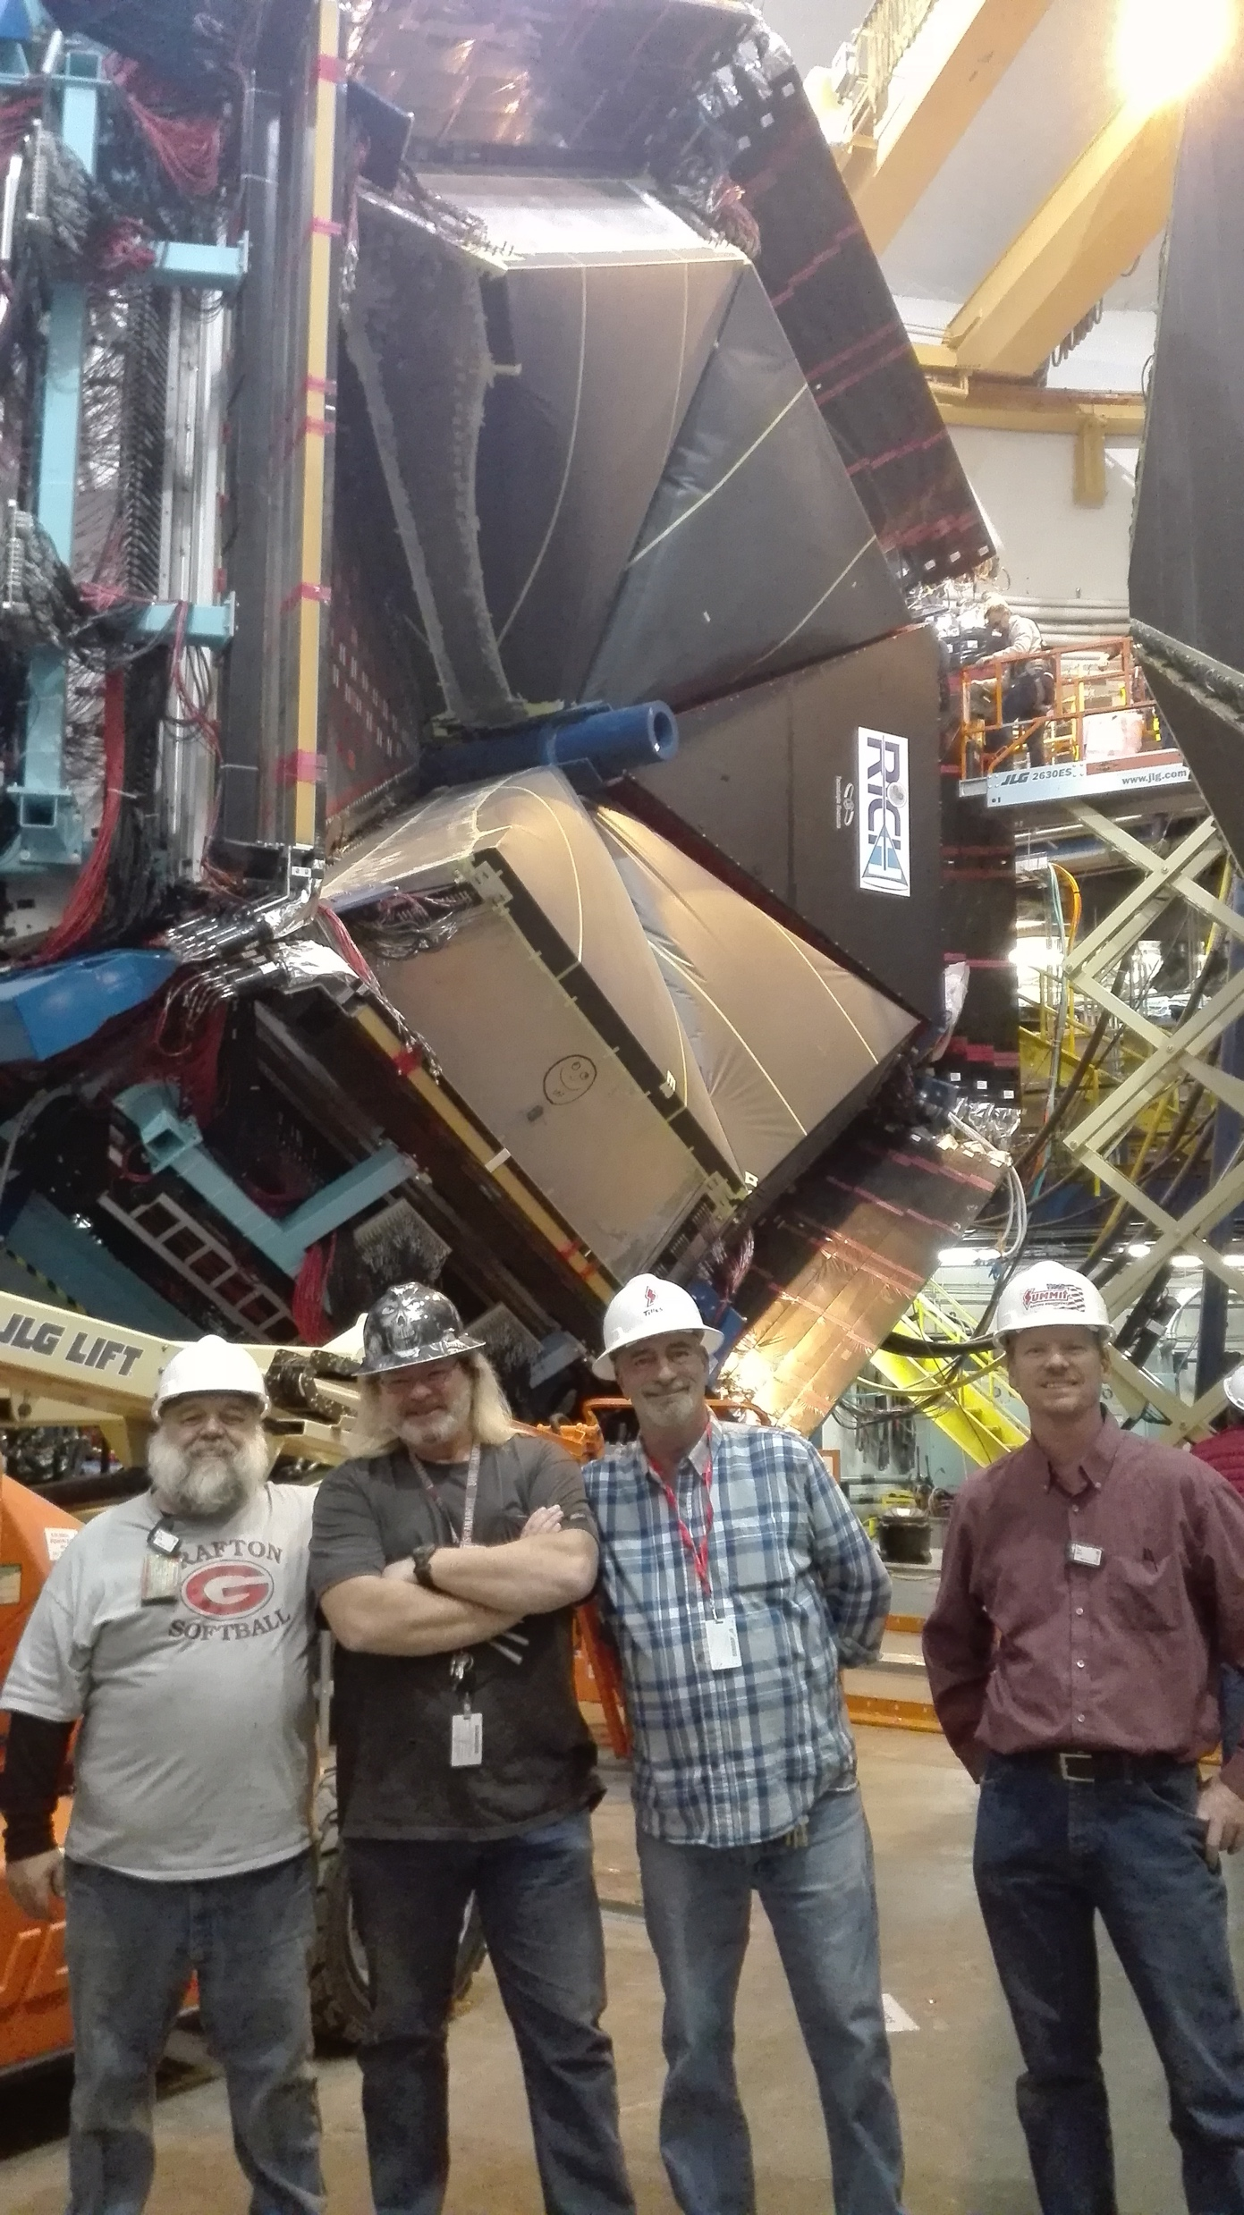
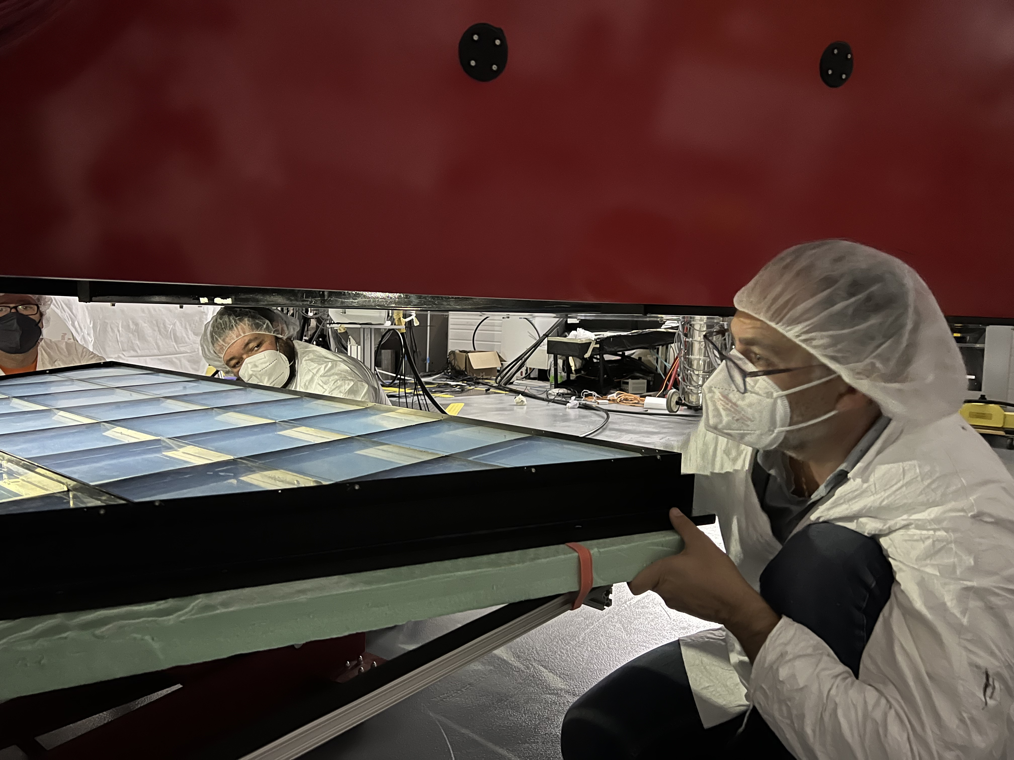
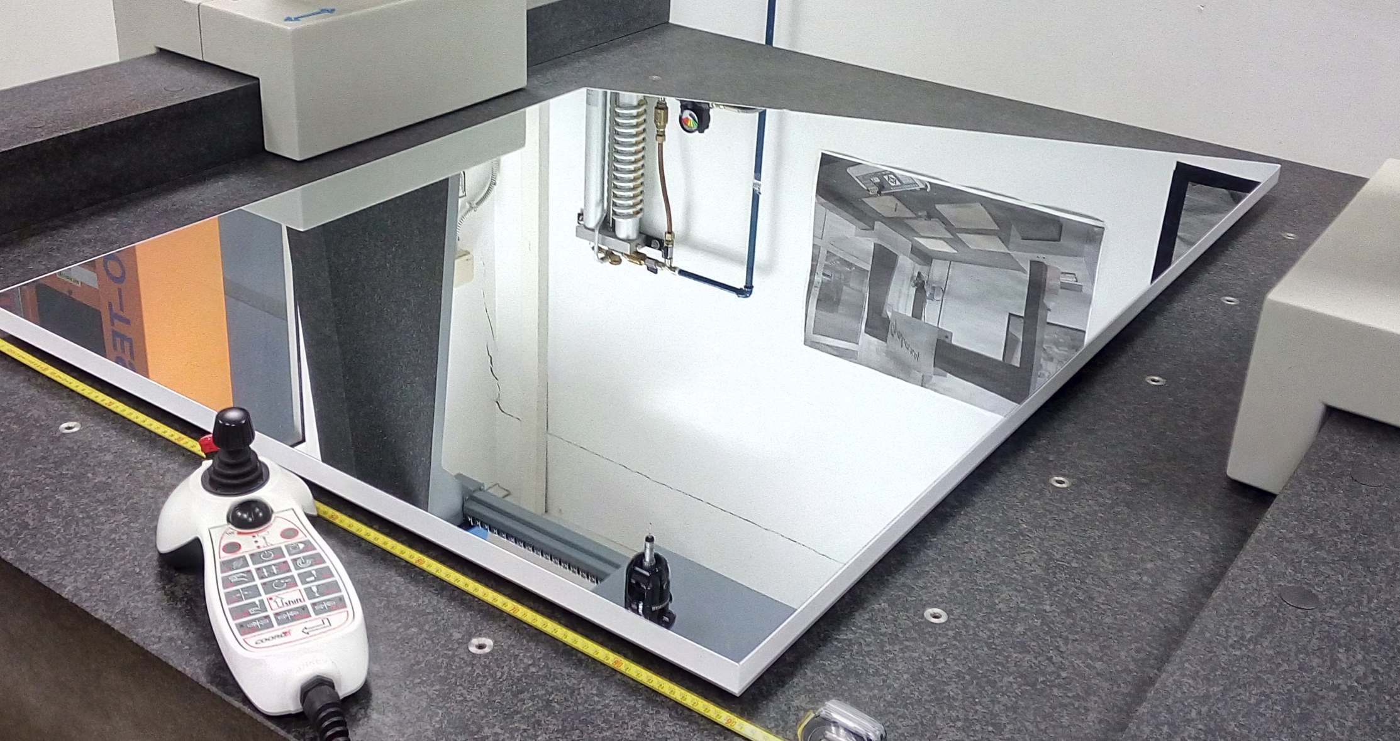
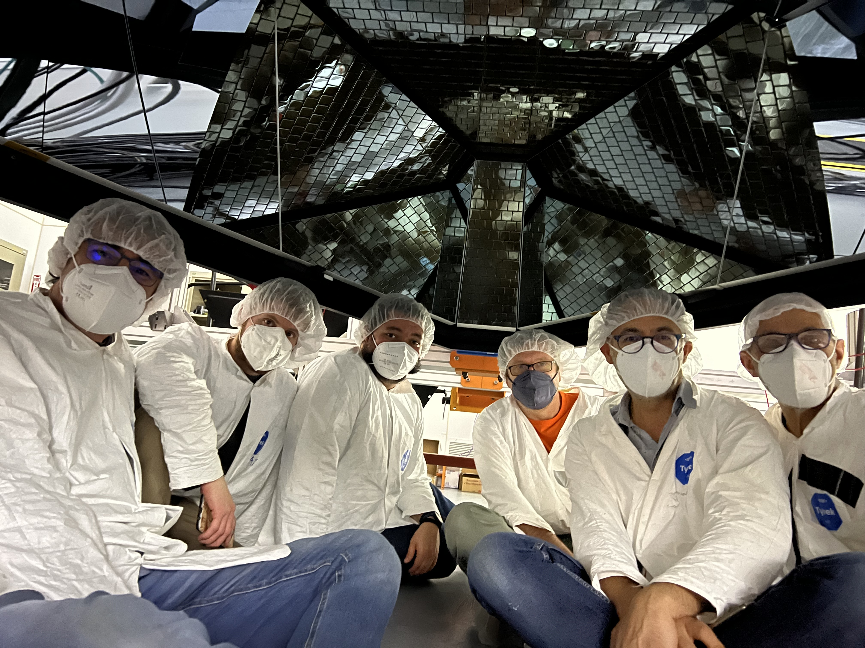
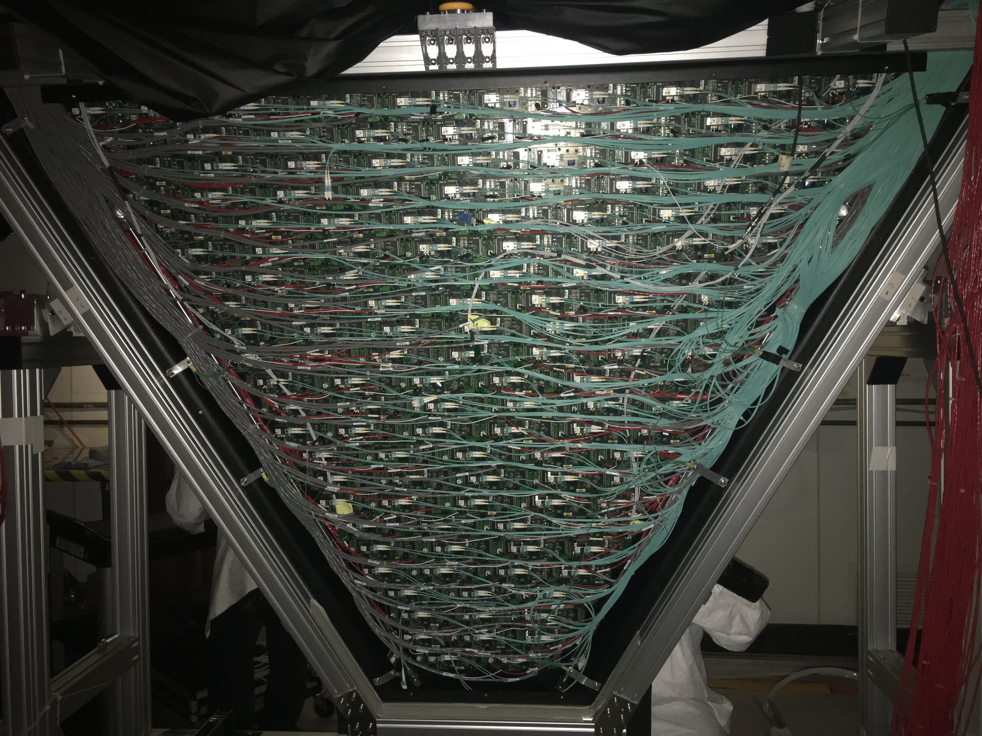
Ring Imaging
Cherenkov (RICH)
Thomas Jefferson National Accelerator Facility
What is it?
RICH In Action
The Ring Imaging Cherenkov Counter is used to:
Discriminate between pions, kaons and protons
When high-energy particles pass through the RICH aerogel traveling faster than the speed of light in that material, they emit photons. This effect (named after the scientist Pavel Cherenkov who first identified it) is like the sonic boom of planes when they accelerate to a speed faster than the speed of sound The angle θ at which this light is emitted, which depends on the particle's speed and the aerogel's properties, can tell us how fast the particle is moving: cos θ =c /nv​, where c=186,000 miles per second is the speed of light, n is the refractive index of the aerogel, and v is the velocity of the particle. The RICH detector measures θ with high precision. By analyzing this angle and the particle's momentum, scientists can identify the type of particle, distinguishing between a pion, a kaon, or a proton.
Left: an event display of a single track in RICH. Can you spont the ring of the Cherenkov light? We collect about 30000 of these events every second. Right: computer simulation of direct ring and reflected arcs onto the photo-sensors for pions, kaons and protons. Our software algorithms reconstruct each particle’s radius and can determine the particle type starting from the few detected photons (red stars).
Our computer simulation of one kaon (yellow line) producing Cherenkov light inside RICH. The white lines are photons produced in the aerogel and detected by the photo-sensors on the left
Is it an UFO? A secret plane being developed in Area 51? It is an inside picture of the RICH: the Photo matrix is centered, surrounded by 10 spherical mirrors on the left, right and bottom.
Tech Specs
Aerogel refractive index: 1.05
Efficiency: 99.8% π/K rejection factor.
Photodetector: 64 channels in each photomulplier (PMT)
Number of PMTs: 782
Total number of channels: 50,048
Data transfer: Fiber Optics.
Spherical mirrors:
Radius: 2.7 m or 9 feet
Area: 3.38 m² or 36 sqft.
Flat mirrors: Glass and Aluminum honeycomb
Two photo-sensors, each 64 pixels.
The state of the front-end electronics and photo-matrix of the RICH detector is monitored in real time. The temperature of the FPGA chips is close to kept below the critical level of 85⁰C by powerful compressor used to cool the electronics. The hardware interlock will shut of both low voltage and high voltage in case of a critical situation and will trigger the alarm for the operators. Top Left: the current temperature of the detector. Top right: status of all 50,048 detector channels.
Building and Installing RICH
Did you know?
Each RICH photo-sensor is a matrix of 64 pixels, each capable of detecting a single photon. As a reference, in normal light conditions our eyes receive about 200 million photons every second. RICH has 391 of these photosensors, for a total of 25,024 pixels.
There are 10 spherical mirrors, 4 lateral and four frontal and one bottom mirrors for a total mirror coverage of 10.3 m² or 111 sqft.
Best in class: Aerogel is a quartz foam, the only material with refractive index between gases and liquids. The RICH aerogel features unprecedented transparency. Aerogel is incredibly lightweight—almost as light as air itself. Aerogel, often referred to as "frozen smoke”.
Best in class: use of glass-skin (0.7 mm) mirrors in particle physics experiments, with a cost one order of magnitude lower than standard composite materials.
About 18 photons are expected for a fully detected direct Cherenkov ring
Valery Kubarovsky near the RICH photo-matrix, which includes 391 photomultipliers worth $1 million.
The last picture of the inside of RICH before covering it up and make it 100% light tight: not even one single photon from daylight is getting inside the box.
Sandro Tomassini, Vincenzo Lucherini. Marco Contalbrigo, Dario Orecchini and the aerogel frame.
All RICH mirrors installed in the frame.
It was a snowing, gorgeous Virginia morning when RICH was transported to Hall-B.
Installation of the second RICH detector was finished in 2022. Two CLAS12 sectors were equipped with RICH.
Like putting back a piece of a pie… very carefully…
One of the RICH mirrors.
We cannot really “see” the differences between this and conventional mirrors, even though the RICH mirror will look flawless.
The real contrast is in the reflectivity of high energy photons: invisible to the human eyes, these are not reflected by conventional mirrors. Only advanced chemical recipes can make mirrors capable of reflecting ultra-violet photons. The company that made the RICH mirrors kept the recipe a secret. You know, like Coca Cola.
Contributing Institutions
Jefferson Lab, Newport News, VA, USA
Istituto Nazionale di Fisica Nucleare, Italy.
Jefferson Lab Detector Support Group and INFN collaborators in front of the assembled RICH shell, March 2017.
Calvin Mealer, Denny Insley, Dough Tilles and Bob Miller. Newport News: RICH is installed.
Detector assembly during the Covid era

